Slide 1
Pompeii & Herculaneum
A.D. 79 August 24

Slide 2
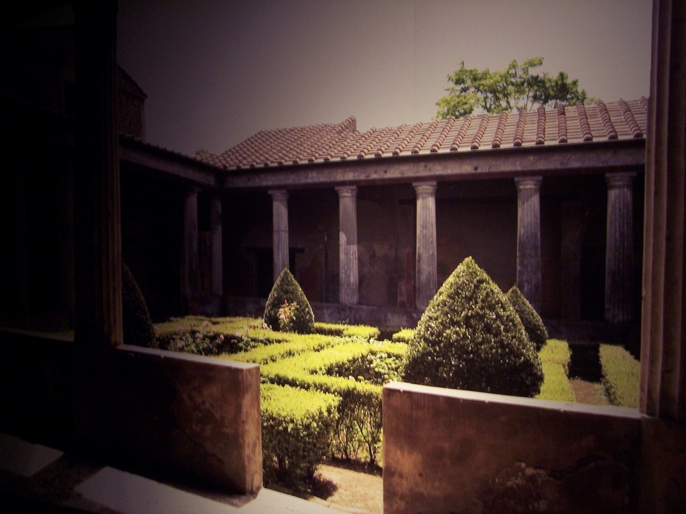
Peristylium, or outdoor garden, of a wealthy resident of Pompeii

Slide 3
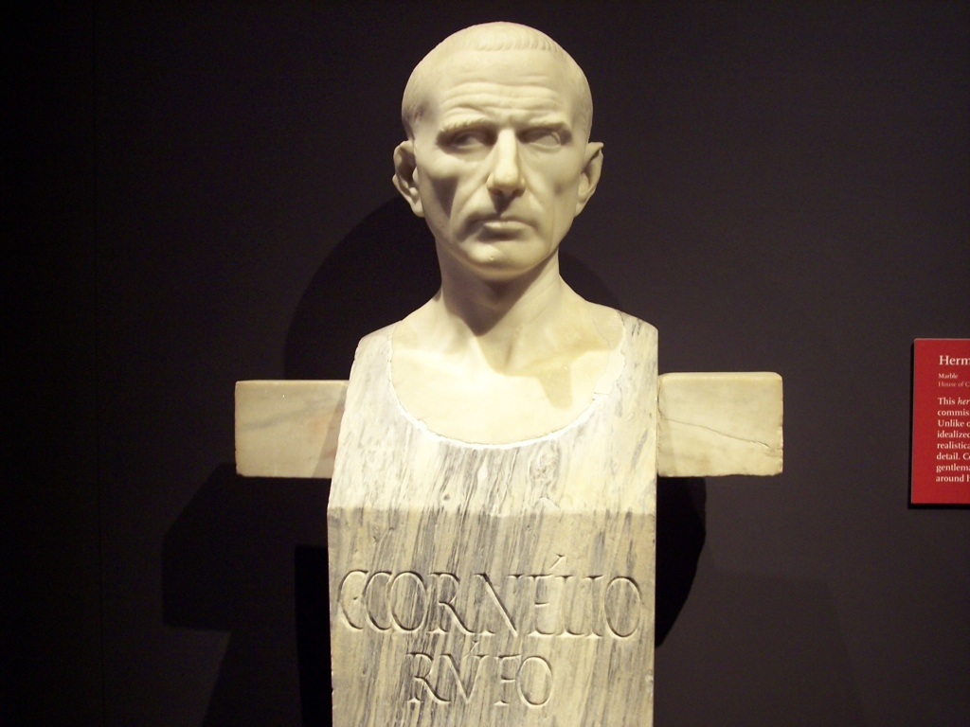
Grave stele for Gaius Cornelius Rufus, a wealthy merchant in Pompeii

Slide 4
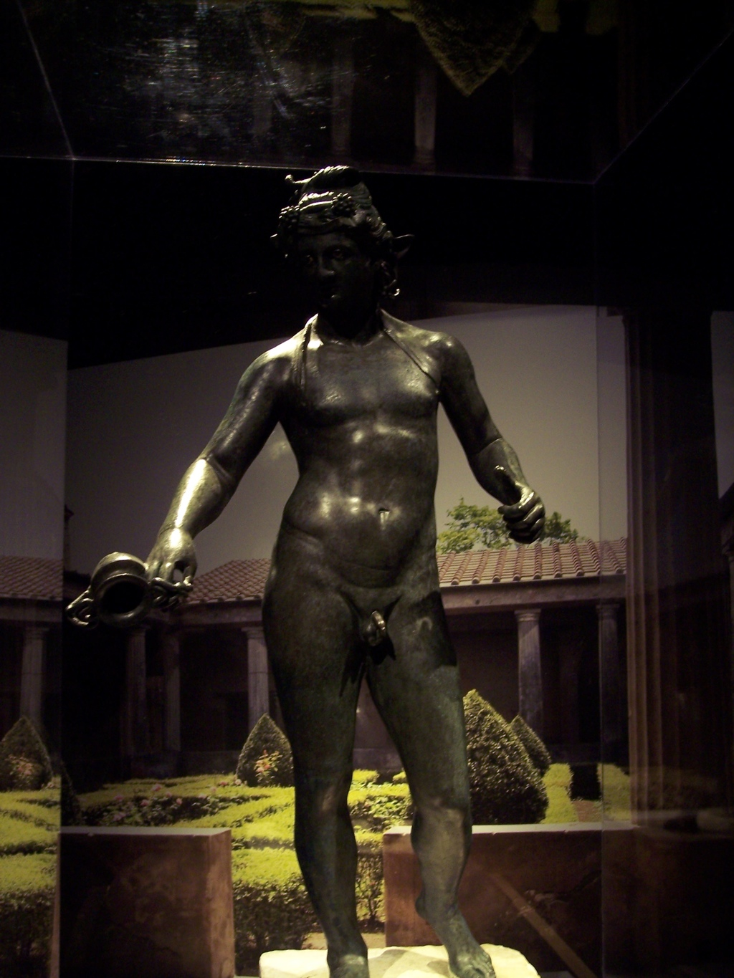
Bronze statue found in the atrium of a wealthy Pompeiian home.

Slide 5
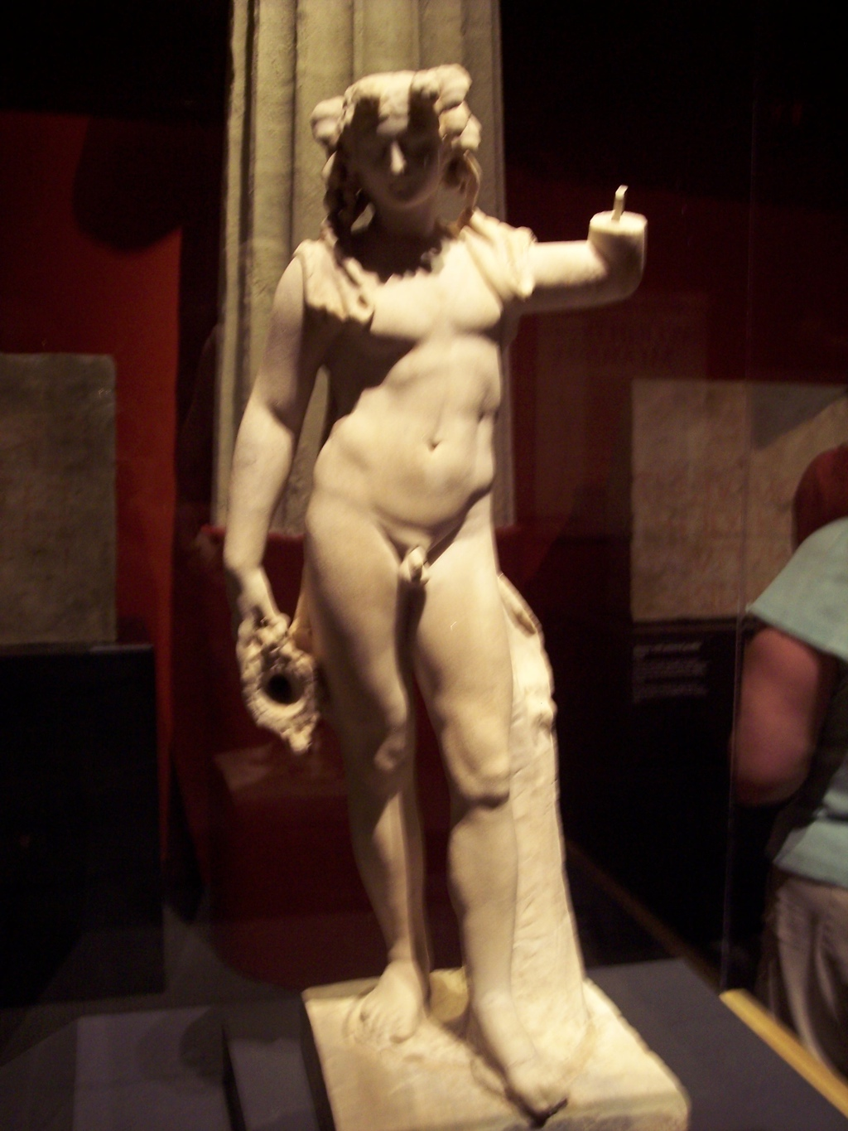
Marble statue of Bacchus, Roman god of wine and parties!

Slide 6
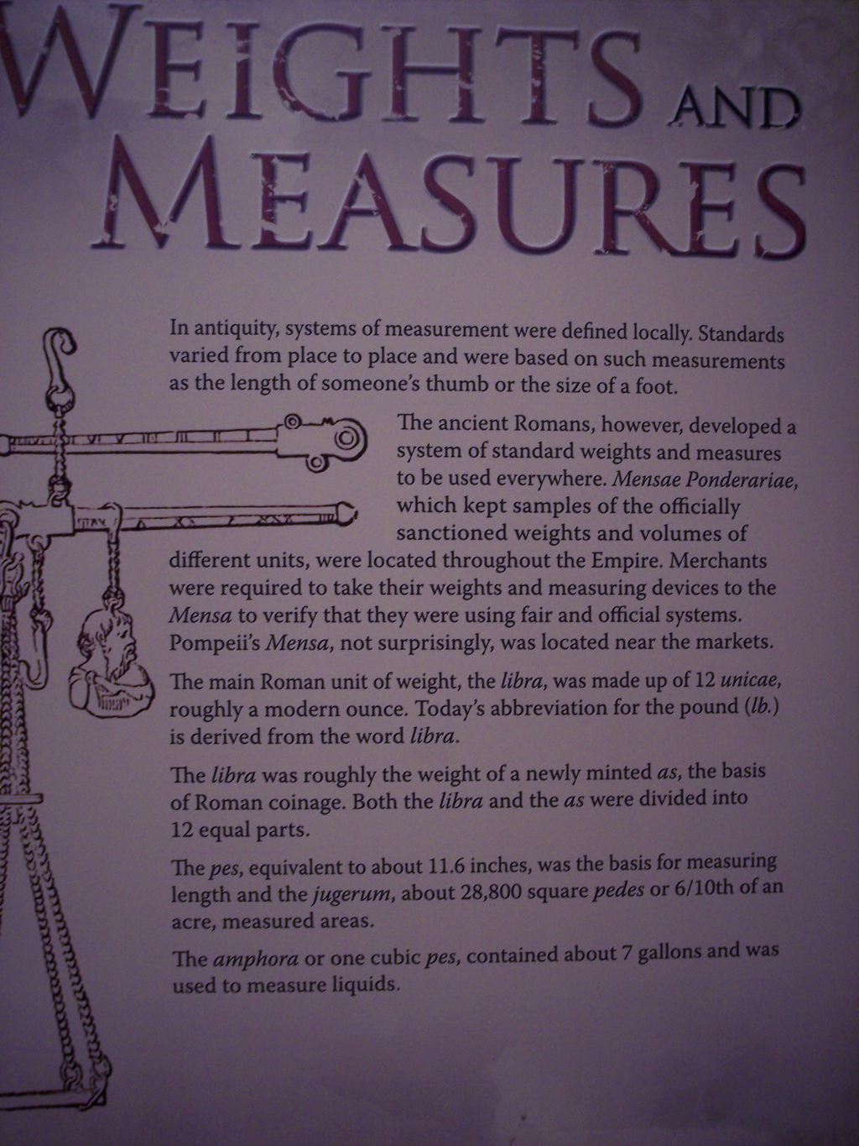
Explanation of Roman weights and measures

Slide 7
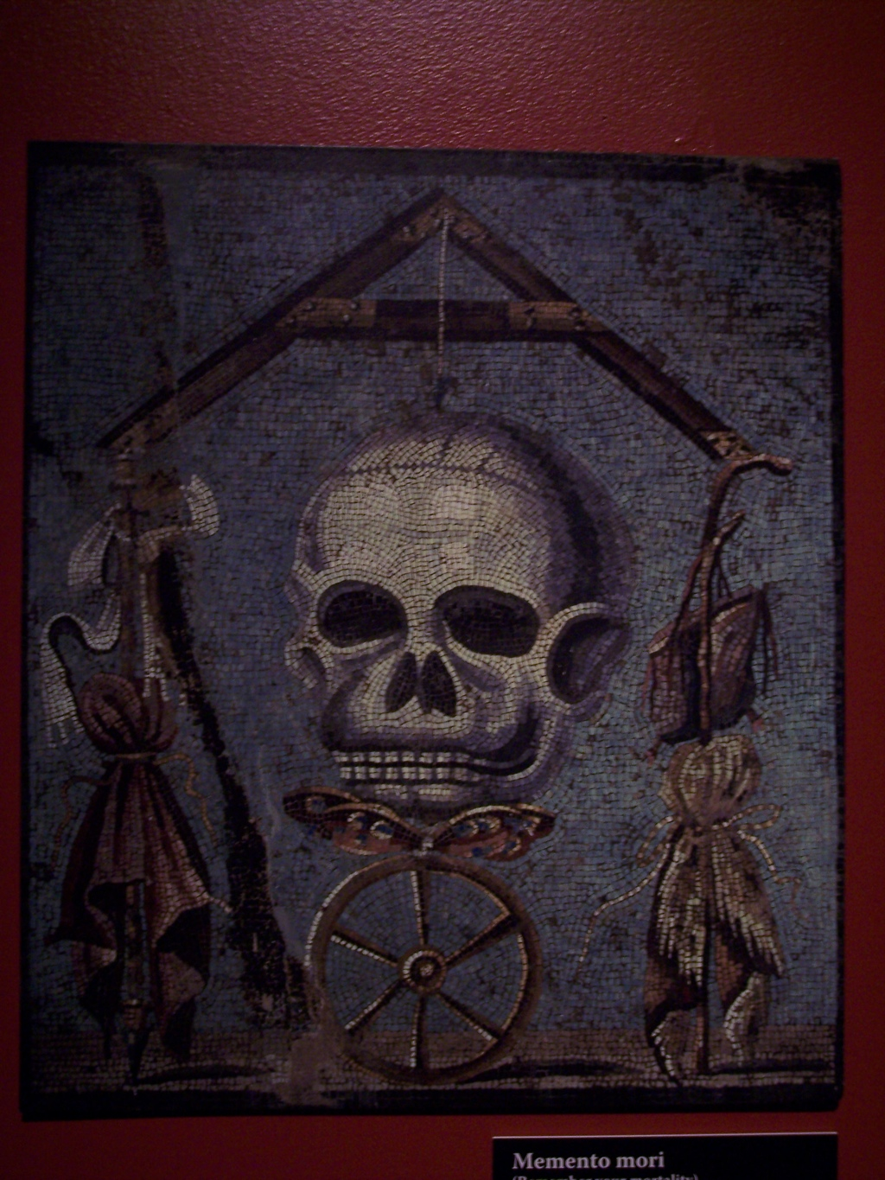
A mosaic with the theme expressed by the Latin “Memento Mori,” “Remember that you will die!”
A sentiment that the Pompeiians kept in mind with Mt. Vesuvius looming in the background.

Slide 8
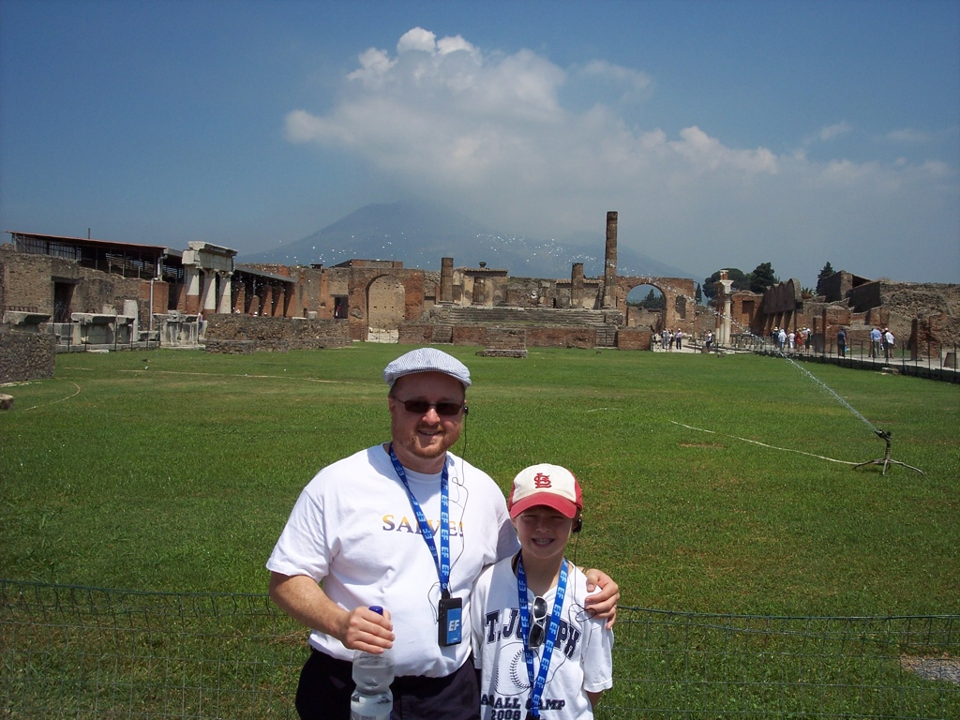
The Forum of Pompeii with Mt. Vesuvius looming in the background.

Slide 9
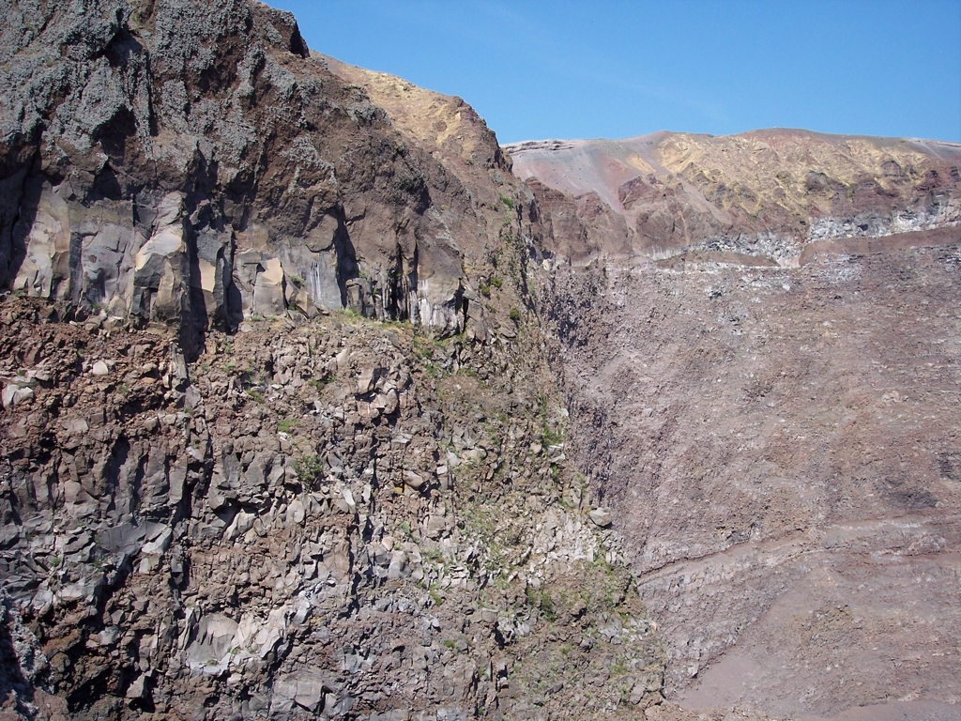
The top of Vesuvius

Slide 10
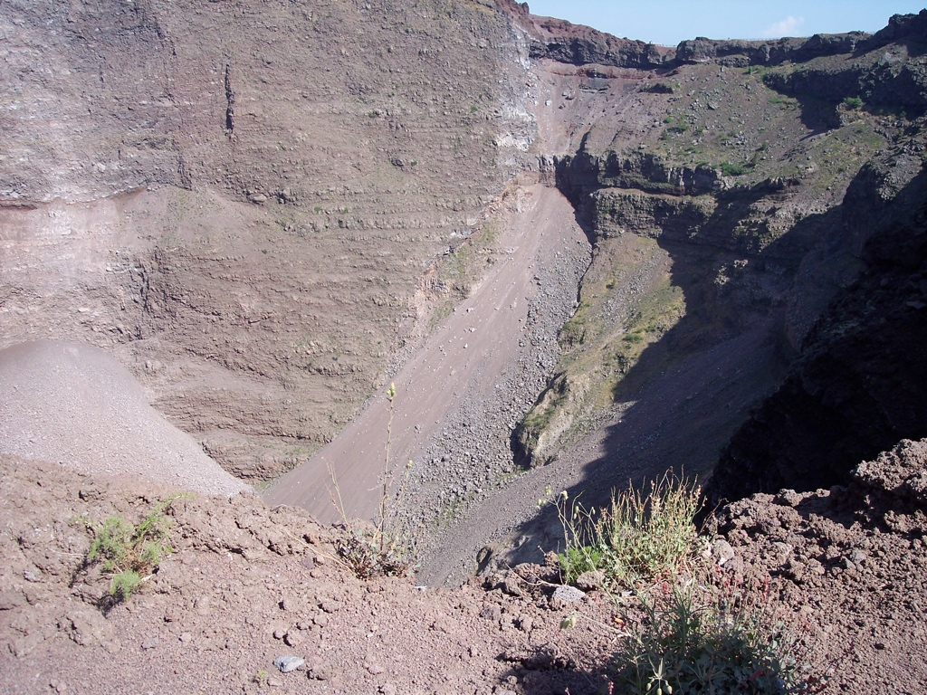
Inside the crater.

Slide 11
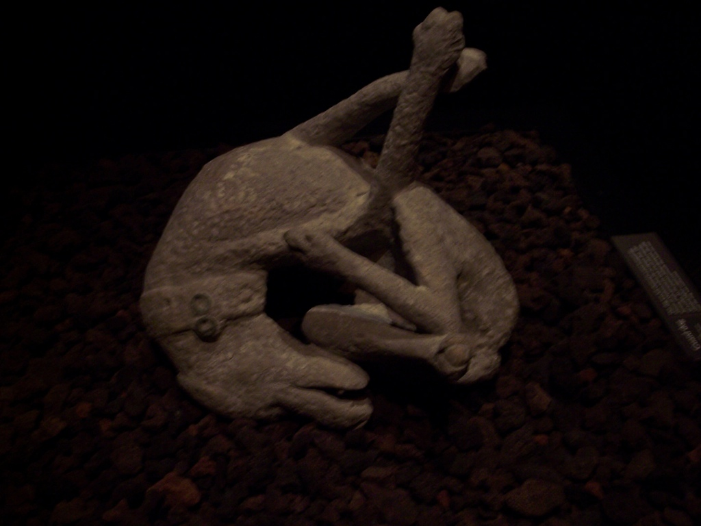
Pompeii

Slide 12
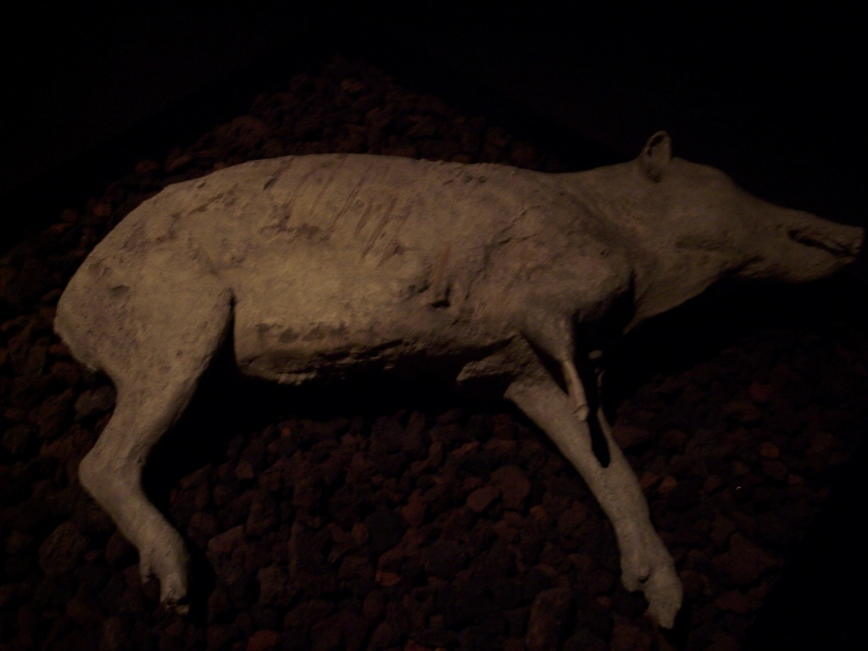
Pompeii

Slide 13
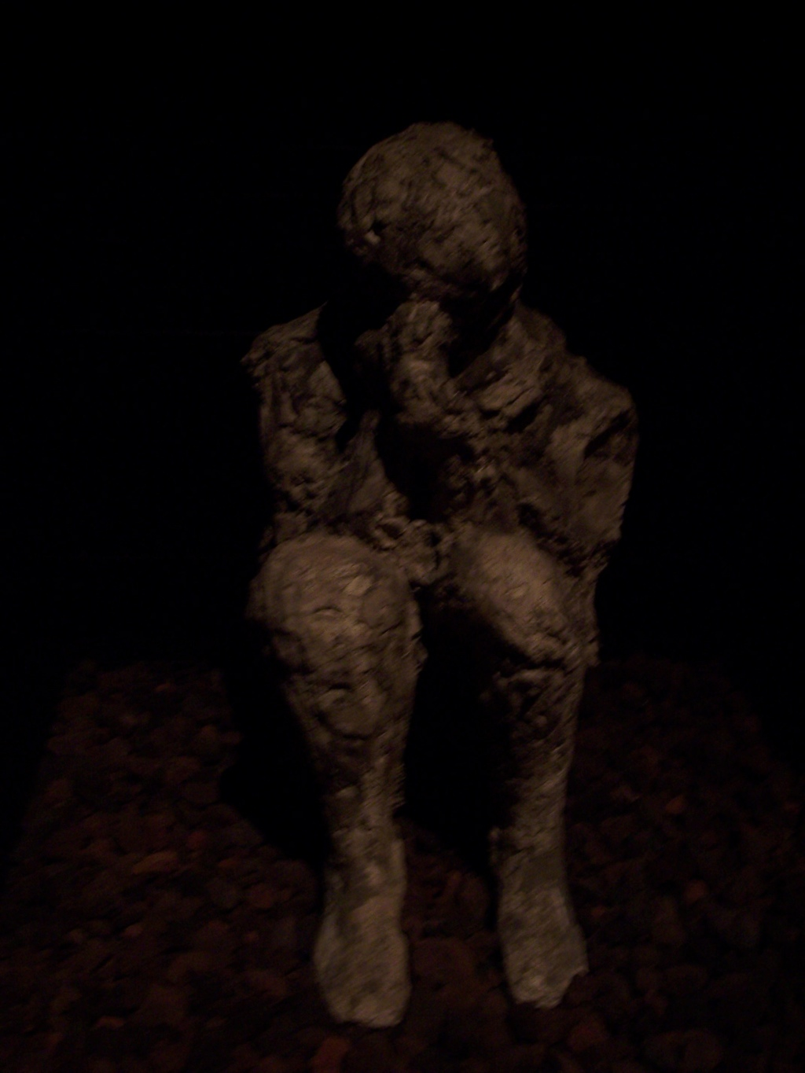
Pompeii
Someone in prayer

Slide 14
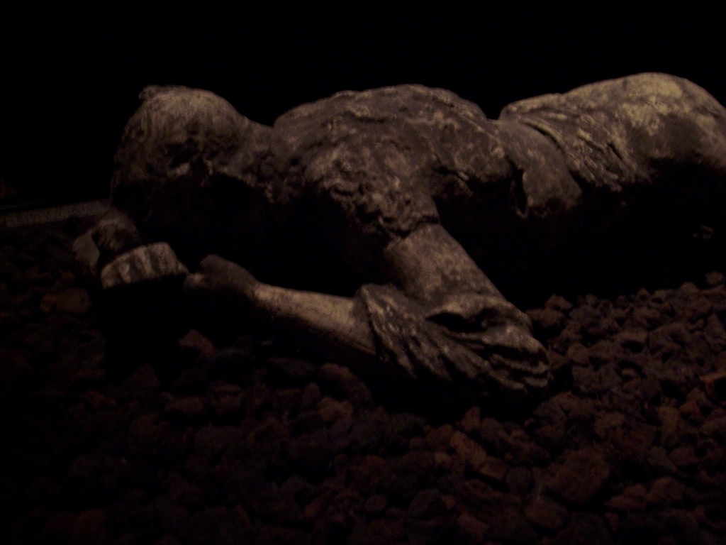
Pompeii

Slide 15
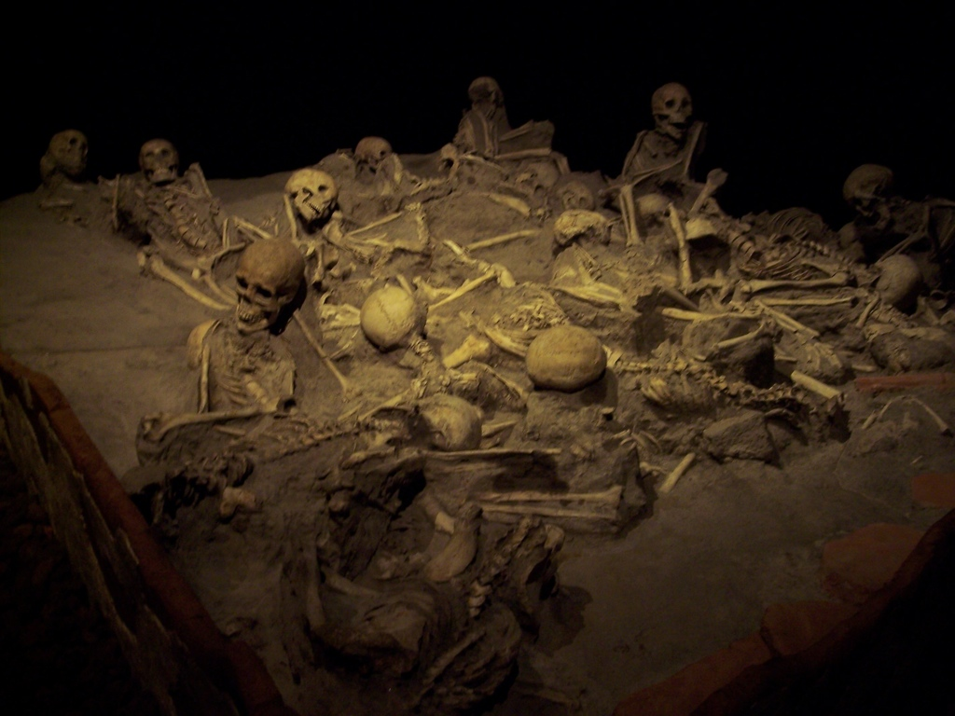
Herculaneum

Slide 16
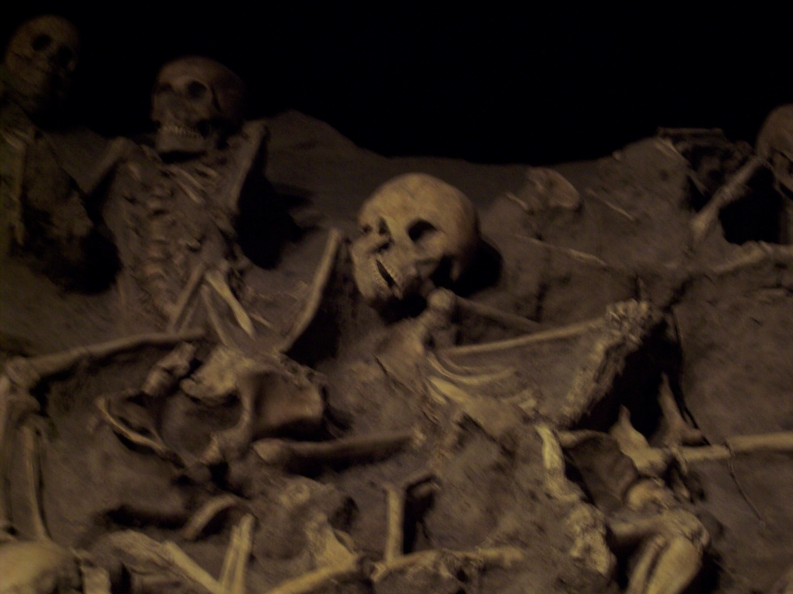
Herculaneum

Slide 17
What would you have done???

