Slide 1
DEADLY STRUGGLES
THE ROMAN CIVIL WARS OF THE 2ND & 1ST CENTURIES B.C.

Slide 2
DEADLY STRUGGLES 146 b.c.
Carthage, Rome’s greatest rival, is destroyed.
Corinth, one of the most powerful cities in Greece, is destroyed.
Rome is the undisputed master of the western Mediterranean world.

Slide 3
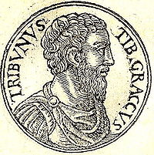
DEADLY STRUGGLES 133 B.C. 133 B.C. 1
Tiberius Sempronius Gracchus, a tribune of the plebes, proposes a land redistribution bill that would have taken land from the senatorial class and given it to the urban poor.

Slide 4
DEADLY STRUGGLES 133 B.C.
Tiberius’ 4 “mistakes”:
He bypasses the senate and takes his bill straight to the comitia tributa.
He circumvents the senate by having the comitia tributa pass a law using the money bequeathed to Rome by King Attalus III of Pergamum to fund his land redistribution.

Slide 5
DEADLY STRUGGLES 133 B.C.
Tiberius’ 4 “mistakes”:
The senate convinces one of Tiberius’ fellow tribunes to veto his legislation. Tiberius then convinces the comitia tributa to recall this tribune from office.
With his term almost over, Tiberius announces that he would stand for re-election to a 2nd consecutive term in order to oversee the land redistribution.

Slide 6
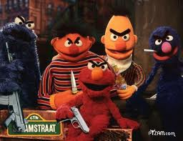
DEADLY STRUGGLES 133 B.C.
A number of senators then organizes a mob and murders Tiberius and some 300 of his followers on the Capitoline Hill.
This was the 1st time in almost 400 years that Romans had killed other Romans in civil strife.

Slide 7
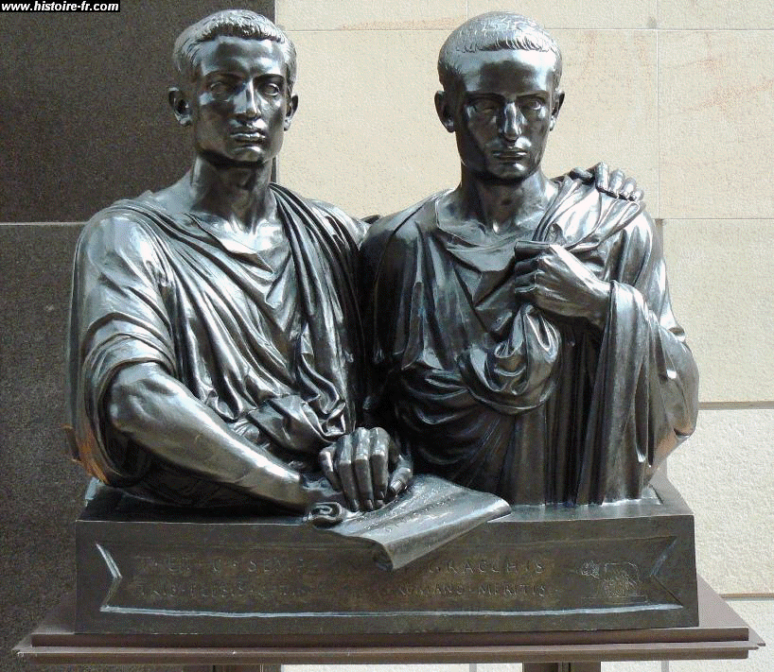
DEADLY STRUGGLES 123 B.C.
Gaius Sempronius Gracchus, the younger brother of Tiberius, is elected as tribune of the plebs. He was just as ambitious as his older brother and he alienated the senate just as badly.

Slide 8
DEADLY STRUGGLES 123 B.C.
Gaius completes his brother’s land distribution.
Gaius weakenes the senatorial control of the courts by adding members of the equites (“knights”) to the juries.
Gaius proposes that Roman citizenship be given to other Italian cities.

Slide 9
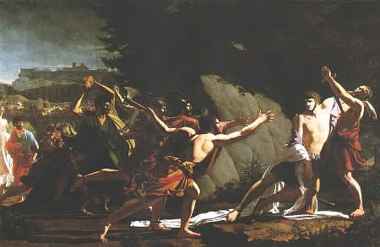
DEADLY STRUGGLES 123 B.C.
Clashes between mobs break out in the city; the senate declares martial law and one of the consuls leads a group of archers, who surround Gaius, who then commits suicide.

Slide 10
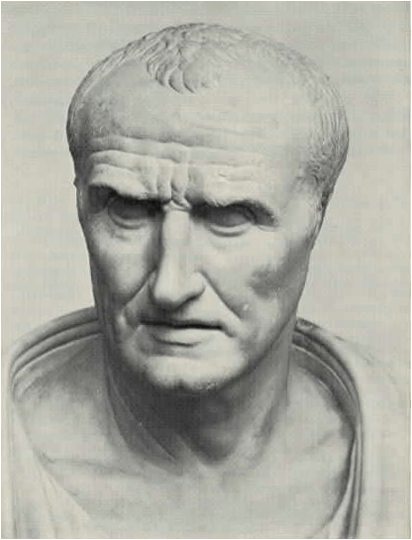
DEADLY STRUGGLES
in 107 B.C. Gaius Marius, a wealthy equestrian and uncle of Julius Caesar, is elected consul. As a Novus Homo, Marius was the 1st in his family to be elected to the consulship.

Slide 11
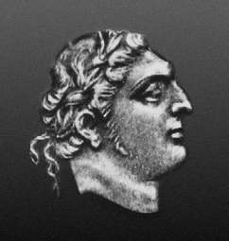
DEADLY STRUGGLES
in 105, Marius leads an army into North Africa where he captures Rome’s elusive enemy, Jugurtha, who is led back to Rome and paraded in the streets before he is executed.

Slide 12
DEADLY STRUGGLES
At this time a terrible famine is striking north central Europe. As a result, millions of Germanic tribesmen begin migrating to the southwest. The Romans, ever mindful of the Gallic invasion of 390 B.C. want their absolute best general to defend their country. That man is Gaius Marius.

Slide 13
DEADLY STRUGGLES
As a result, Marius is elected to 5 consecutive consulships during the years 104-100 B.C. This was unprecedented in Roman history and would hint at the tyranny that would come later under men like Sulla, Pompey, and Caesar.

Slide 14
DEADLY STRUGGLES
One result of Marius holding these successive consulships is that the soldiers in the army become loyal to their leader (i.e. Marius) and not the senate, the body that had traditionally been in charge of the army.

Slide 15
DEADLY STRUGGLES 90 - 88 B.C.
The “Social Wars”
These are fought between Rome and her Italian allies (“socii”) over the granting of citizenship to the allied cities of Italy who had been providing money, supplies, and men for Rome’s foreign wars.

Slide 16
DEADLY STRUGGLES 90 - 88 B.C.
The “Social Wars”
The Italians fight bravely, but the Romans are ultimately victorious and very brutal in their punishment of rebellious cities. However, citizenship is eventually granted to the allied cities.

Slide 17
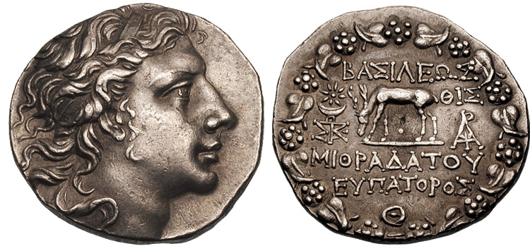
DEADLY STRUGGLES 88 B.C.
Mithridates, King of Pontus, orders the massacre of 80,000 Roman citizens in the middle east.

Slide 18
Pontus

Slide 19
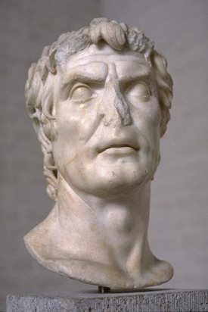
DEADLY STRUGGLES 88 B.C.
The senate, whose traditional domain was foreign affairs, puts Lucius Cornelius Sulla in charge of the war against Mithidates.

Slide 20
DEADLY STRUGGLES 88 B.C.
Sulla came from a patrician family who had recently become impoverished. He was eager to restore the family name (and wealth) and a victory over mithridates would provide this.

Slide 21
DEADLY STRUGGLES 88 B.C.
Sulla had served on Marius’s staff in the war against Jugurtha and in fact was the Roman who had actually captured Jugurtha.

Slide 22
DEADLY STRUGGLES 88 B.C.
Marius convinces (or bribes) a tribune named Publius Sulpicius Rufus to pass a law in the comitia tributa to give the command of the war against Mithridates to himself.

Slide 23
DEADLY STRUGGLES 88 B.C.
Sulla, who had been busy training his troops in southern Italy, marches on Rome.
Marius, who knew he was no match for Sulla and his well trained troops, flees to Africa.
Sulpicius is caught, beheaded and his severed head is placed on the rostrum in the forum.

Slide 24
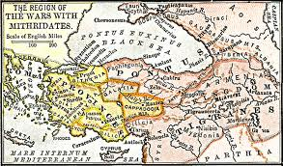
DEADLY STRUGGLES 88 B.C.
Sulla kills many of Marius’s supporters and regains his command against Mithridates.
Sulla then leads his troops overseas to Pontus to fight Mithidates.

Slide 25
DEADLY STRUGGLES 87 B.C.
While Sulla was in the east fighting against Mithridates, Marius returns to Rome, murders many of Sulla’s supporters, and is elected to his 7th and final consulship. He then dies shortly thereafter.

Slide 26
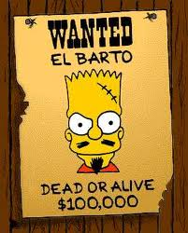
DEADLY STRUGGLES 83 B.C.
Sulla returns to rome with vengeance on his mind. after taking over the city, he institutes his infamous “proscription Lists.” If one’s name appeared on this list, anyone cold hunt him down, kill him, and receive a bounty from Sulla. All the proscribed person’s money and property would be transferred to the state treasury which was controlled by Sulla.

Slide 27
DEADLY STRUGGLES

Slide 28
DEADLY STRUGGLES

Slide 29
DEADLY STRUGGLES

Slide 30
DEADLY STRUGGLES

Slide 31
DEADLY STRUGGLES

